Slide 1
Arrowhead Framework: SoSD Wind Farm
Feb 03, 2020 Saleha Javed

Slide 2
1
Problem Statement
WHAT
2
Target Solution
WHY
3
Designed Solution
HOW

Slide 3
WHAT!
Problem Statement
Wind Mill Local Cloud Architecture

Slide 4
Problem Statement
Build wind mill local cloud. All three mandatory core systems shall be used.
Build Central wind farm local cloud.
Enable inter cloud communication using Gatekeeper and Gateway systems such that data from a wind mill local cloud DataManager can be transferred and stored at DataManager in the Wind farm local cloud.
Provide ML data analysis services to the local cloud based on ML code from Sergio.

Slide 5
Cont.
Prevention of sudden and unexpected stops in wind turbine
Contineous monitoring of wind turbine to ensure proper operations
Track day-to-day maintenance operations
A condition-monitoring component should compute analytics from all sensors data
Derive necessary output values
Warn when abnormal behavior occurs

Slide 6
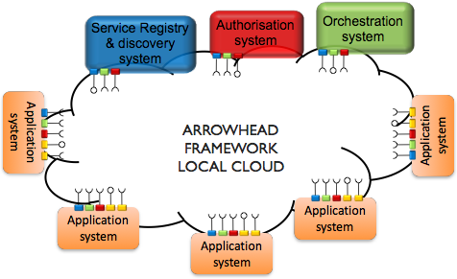
A Wind Mill Local Cloud Architecture
DataManager

Slide 7
A Wind Farm Local Cloud Architecture
Data
Manager
Data
Manager
Central Cloud
Data
Manager

Slide 8
Work Flow: Wind Farm Local Cloud
Authenticator
Consumer
Wind Mill Local Cloud A
Authenticator
Service Registry
Application System A
Orchestrator
Service Registry
Data Manager
Provider
Orchestrator
Provider
Wind Mill
Local Cloud B
Consumer
Data Manager
Data Manager
Provider
Application System A
Orchestrator
Authenticator
Consumer
Service Registry
Wind Farm Central
Local Cloud
Application System A

Slide 9
WHY!

Slide 10
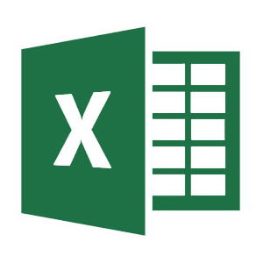
WHY?
Compute analytics from huge Turbines Data. Each sensor data should provide as 5 Outputs:
1
Average Values
2
Maximum Values
3
Minimum Values
Initial Segment Value
5
4
End Segment Value

Slide 11
HOW!
Mind Map
Solution Design
System Design
Demo

Slide 12
Biggest Challenge!
Authenticator
Consumer
Wind Mill Local Cloud A
Authenticator
Service Registry
Application System A
Orchestrator
Service Registry
Data Manager
Provider
Orchestrator
Provider
Consumer
Data Manager
Data Manager
Provider
Application System A
Orchestrator
Authenticator
Consumer
Service Registry
Wind Farm Central
Local Cloud
Application System A

Slide 13
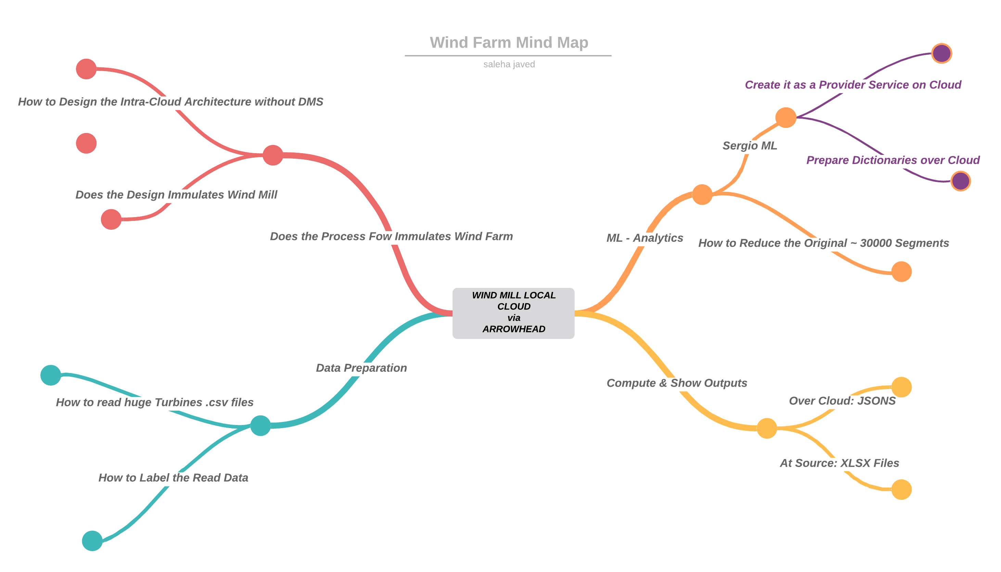
Mind Map

Slide 14
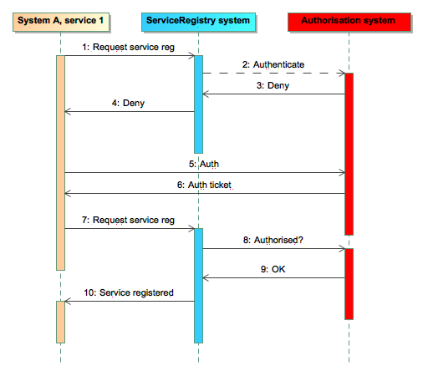
Wind Mill Local Cloud Core Systems
Process Flow

Slide 15
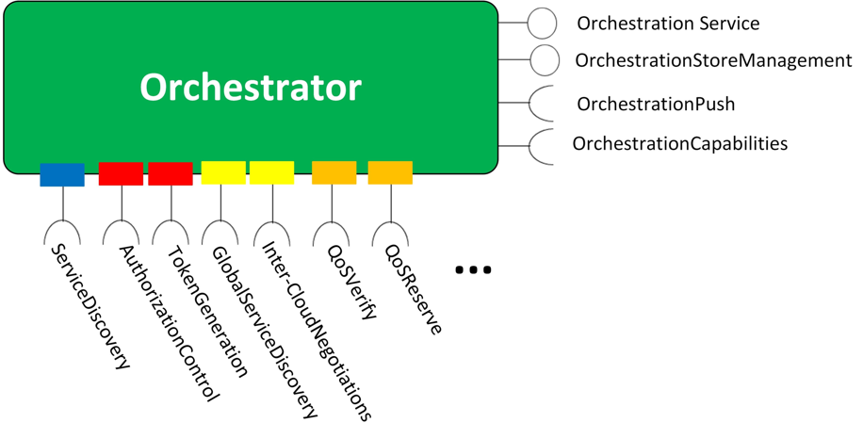
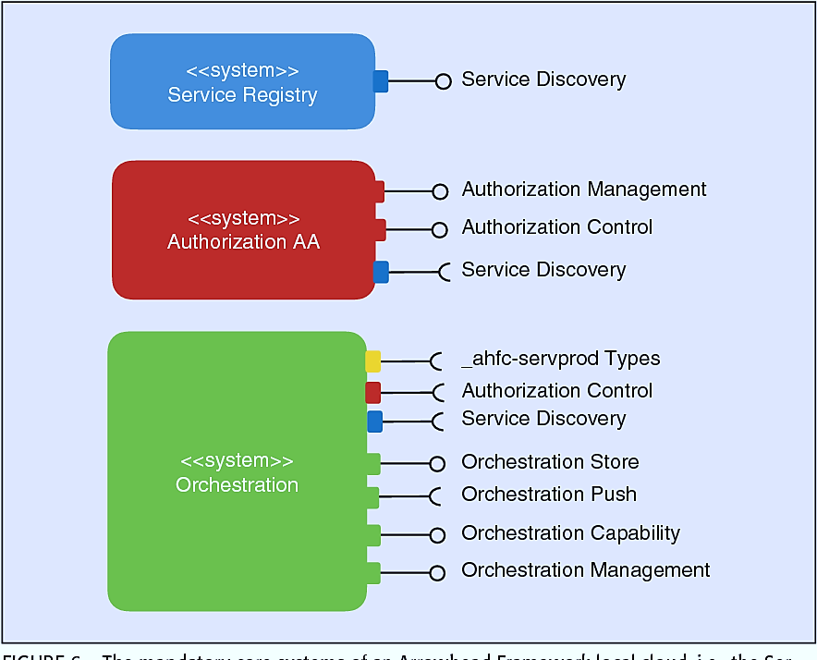
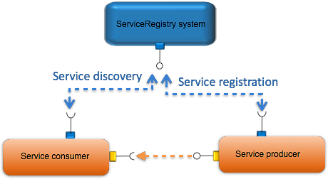
Core Systems

Slide 16
Provider system
Runs on localhost, Port 5000
Consumes services as:
Echo services of all the core systems of arrowhead.
Registering provider system
Registering services.
Provide services:
Analytics: ML
Analytics: Average (basic)

Slide 17
Consumer system
Runs on localhost, Port 5001
Consumes services as:
Echo services of all the core systems of arrowhead.
Registering system
Authorization for consuming provider services
Consumes Provider: Analytics: ML service
Provide service
Notifi.

Slide 18
Challenges faced
Architecture Level Issues:
Datamanager system had been pulled from github and did not exist in current Version:4
No documentation of the system was placed
Re-designing the proposed architecture
Time Lapse / Computation Issues:
ML component execution on target file with 30000 segments was last time started 3 days ago and it is still computing
Different reduced sets of problem took:
40-50 Minutes for 10 segments
20-30 Minutes for 5 segments

Slide 19
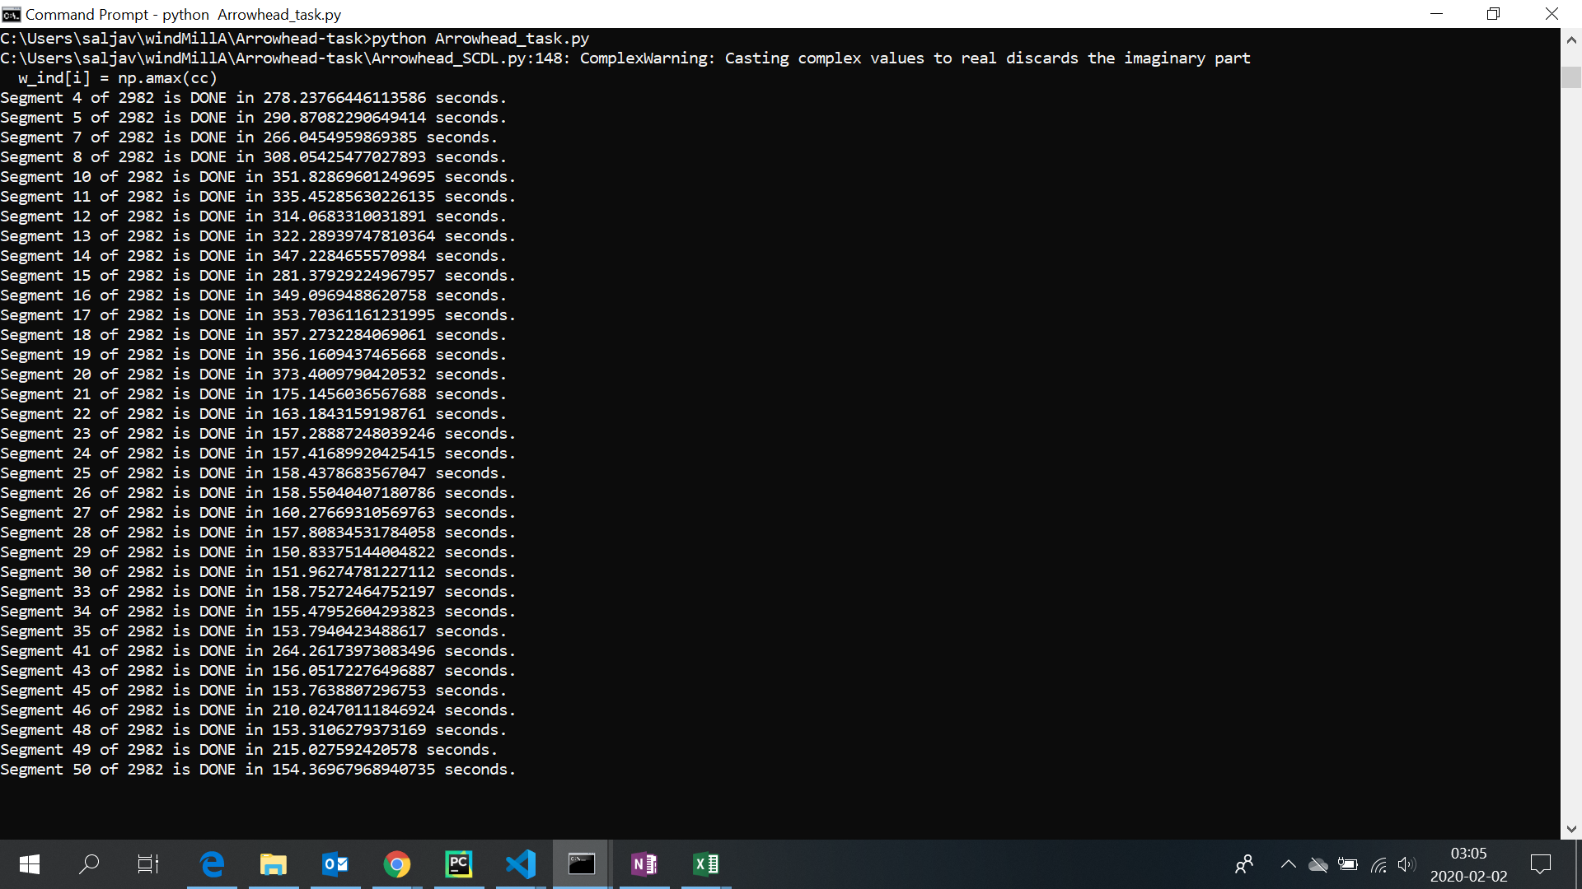

Slide 20
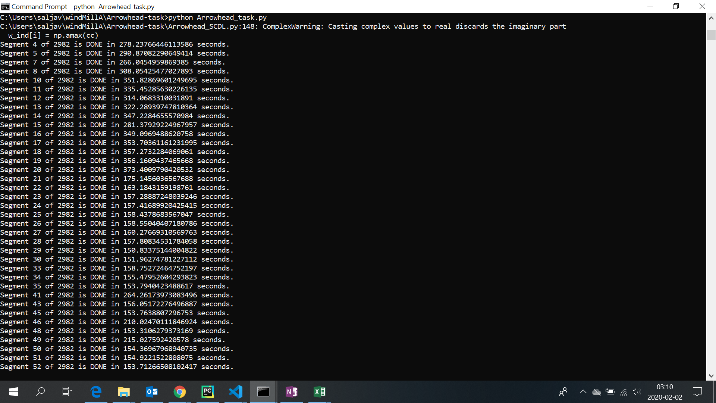

Slide 21
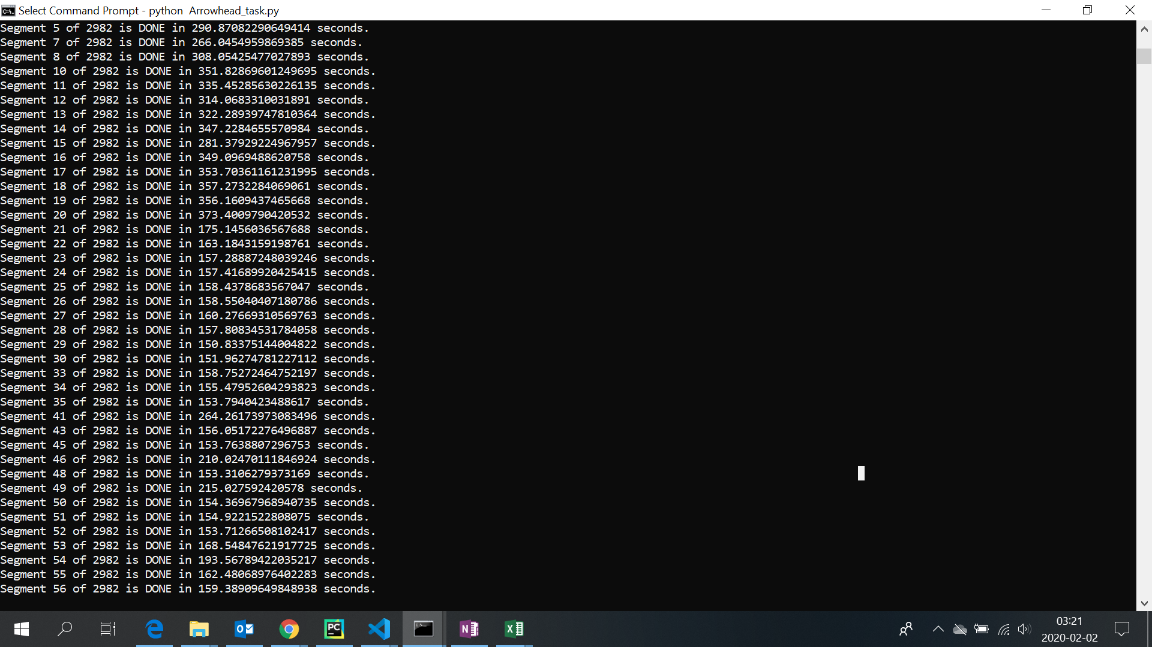

Slide 22
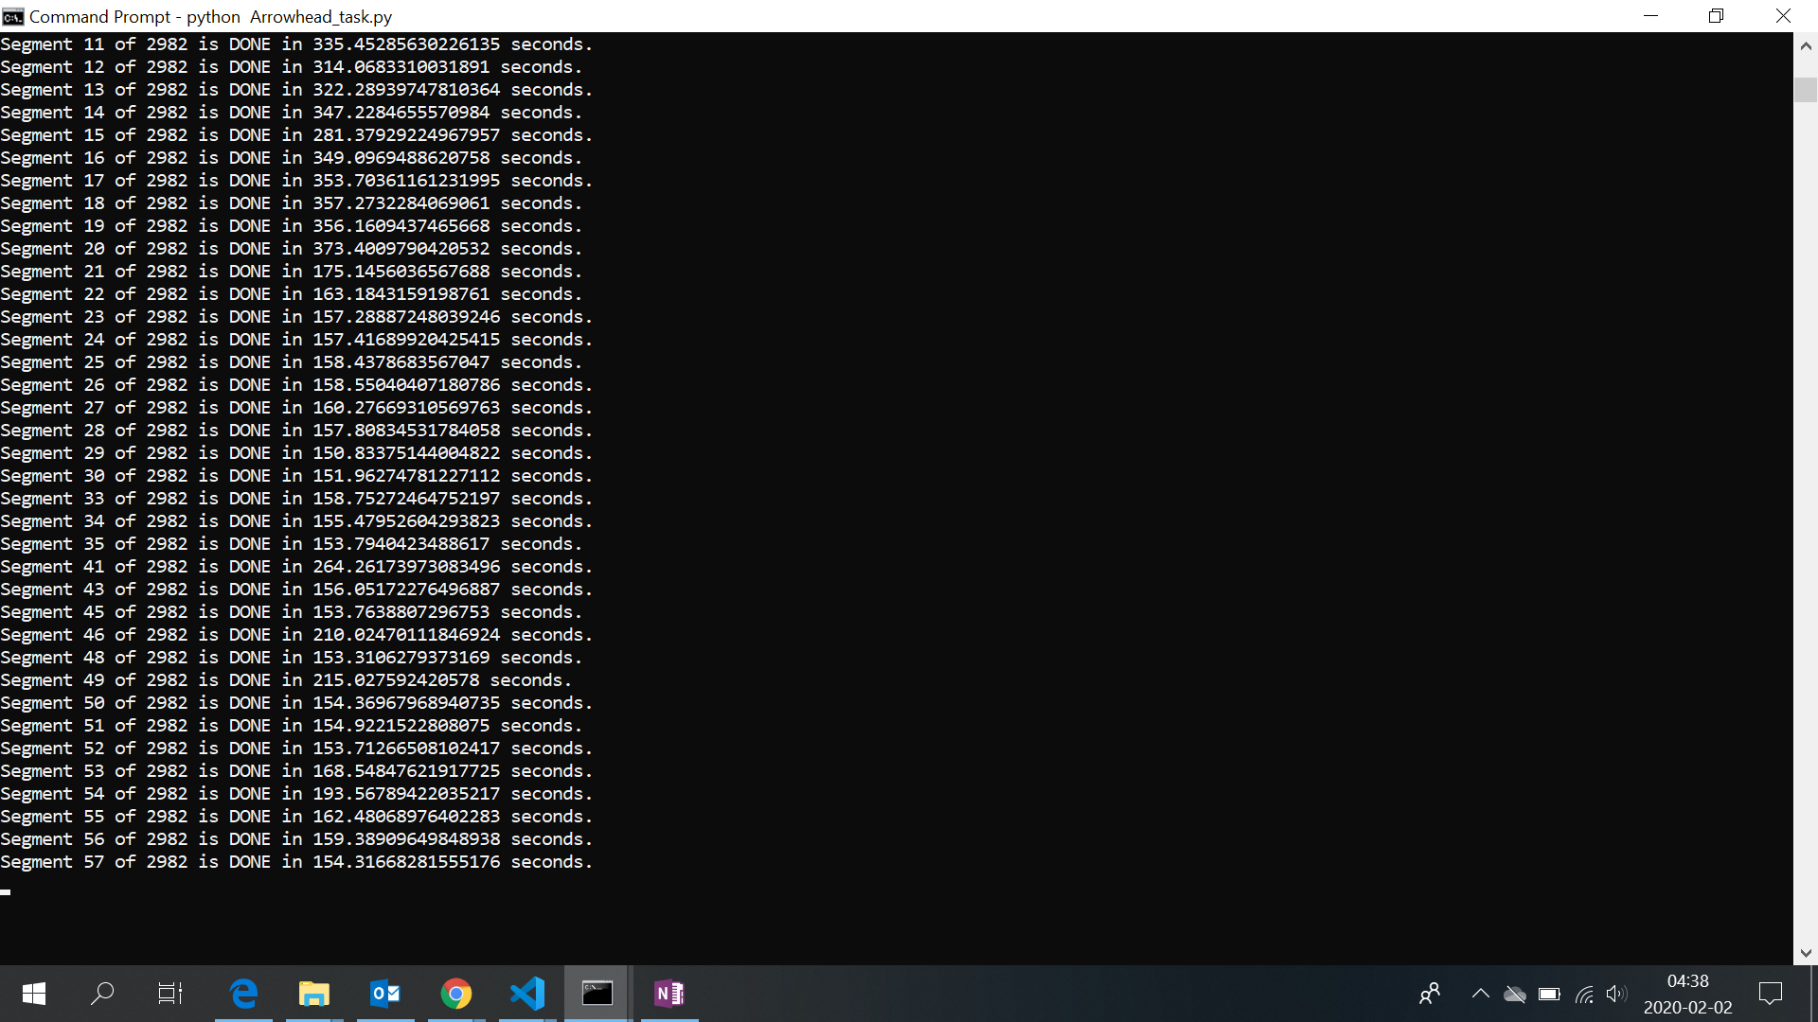

Slide 23
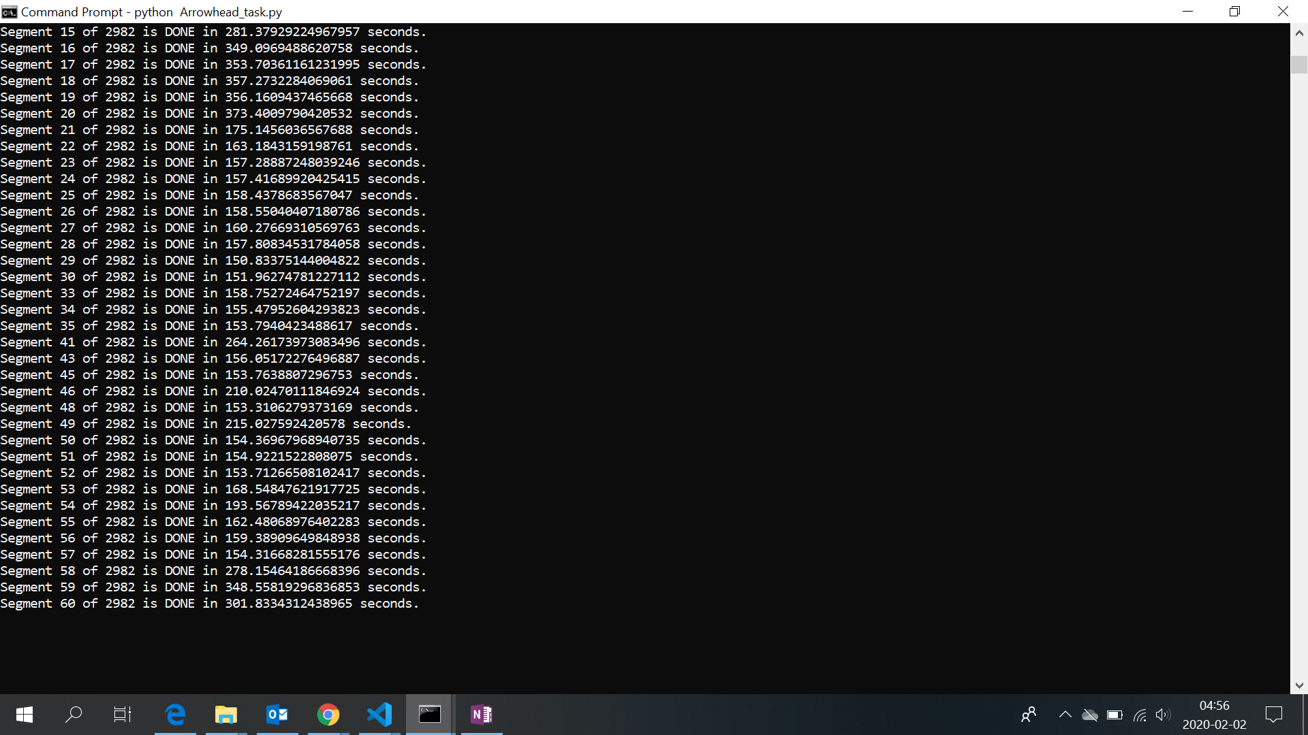

Slide 24
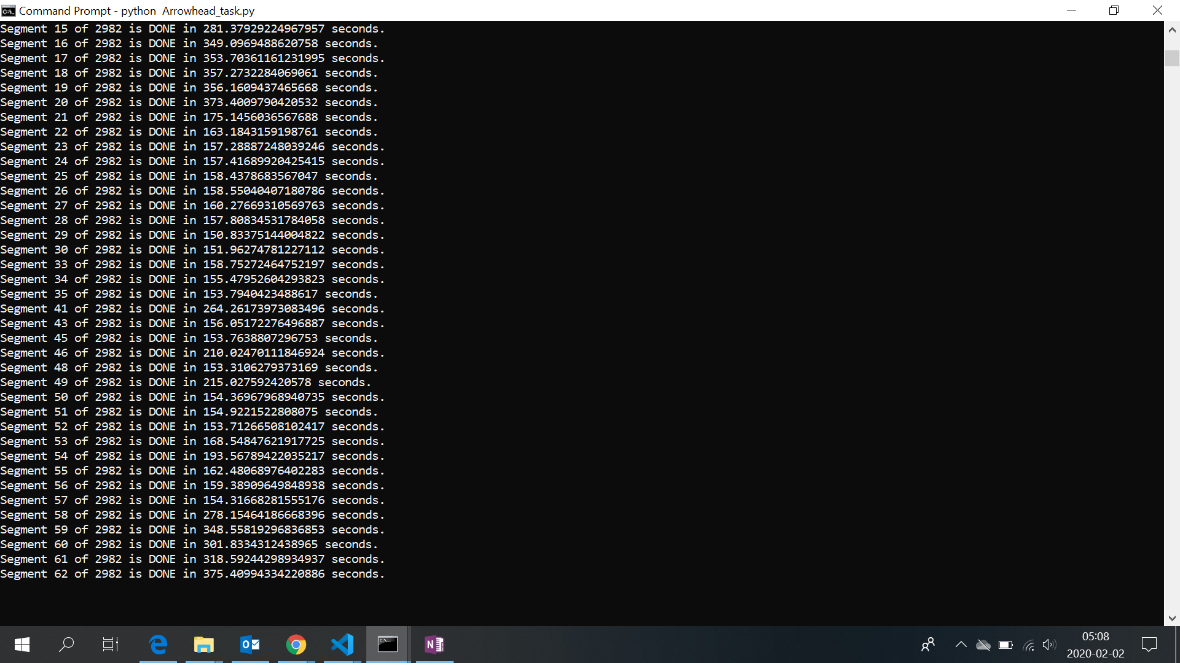

Slide 25
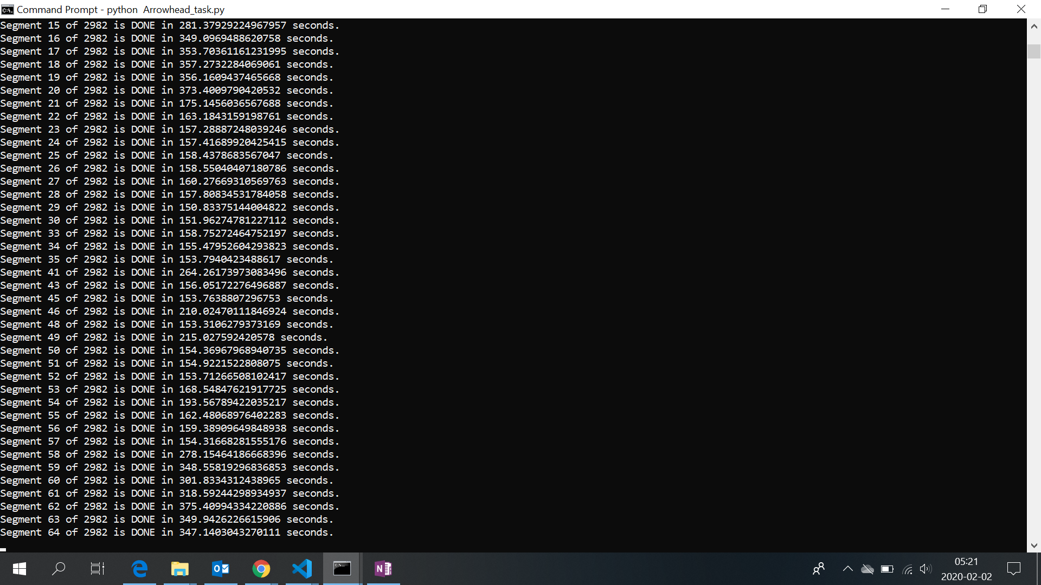

Slide 26
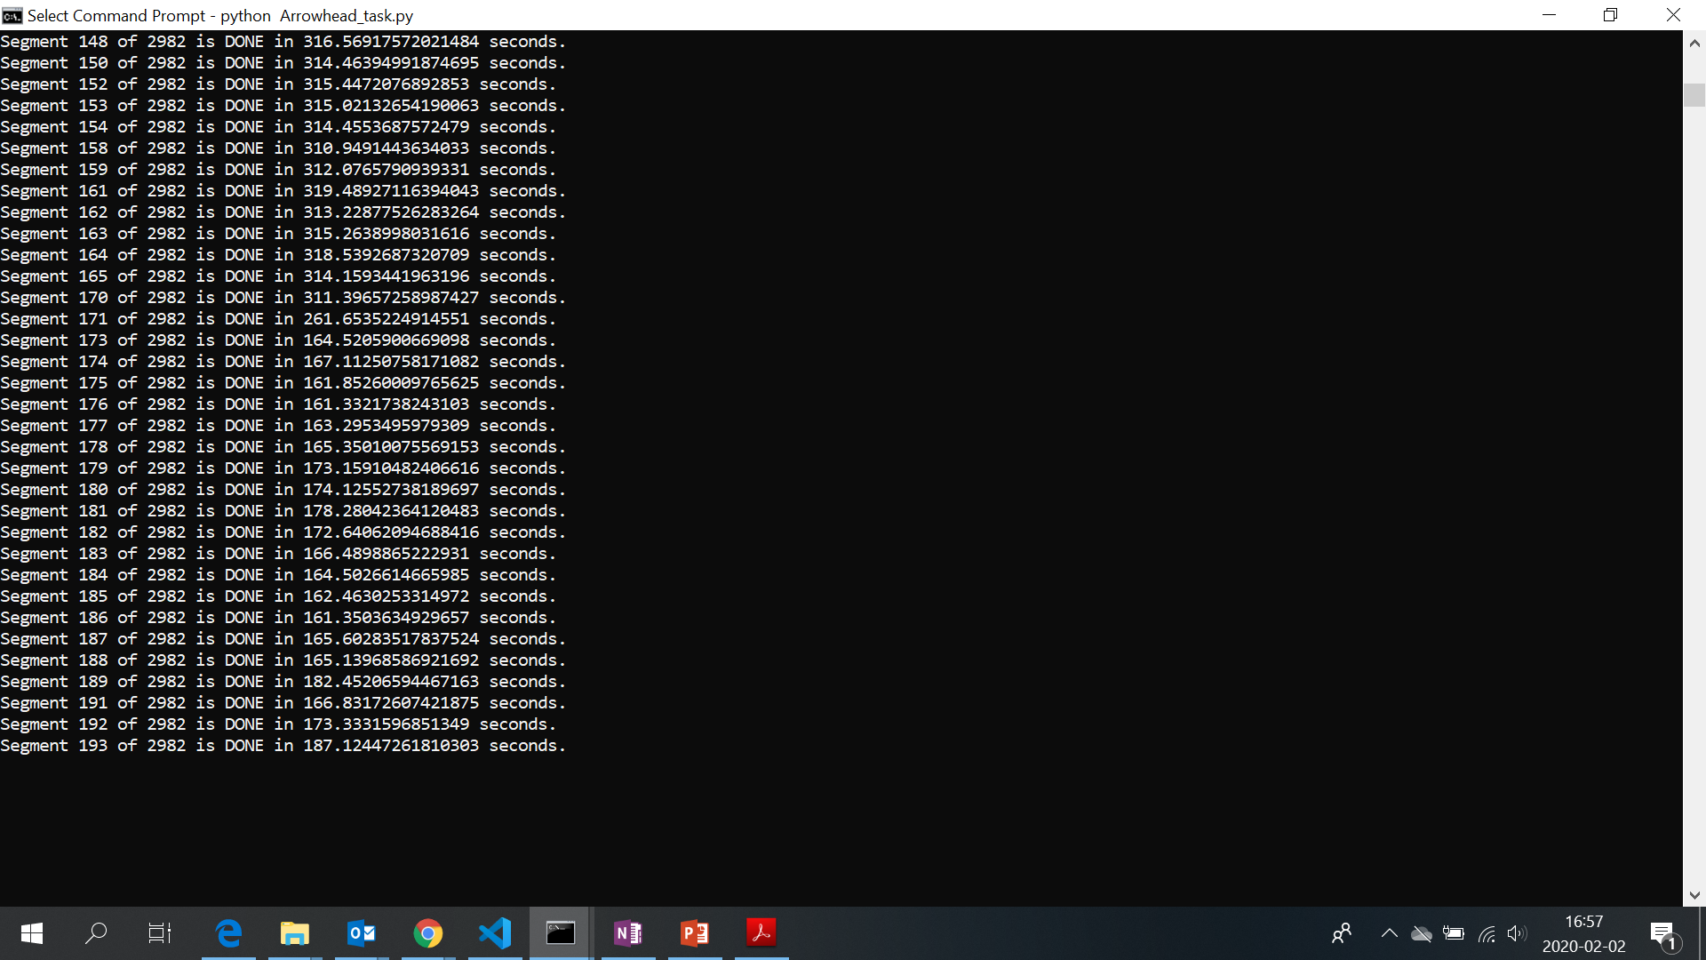

Slide 27
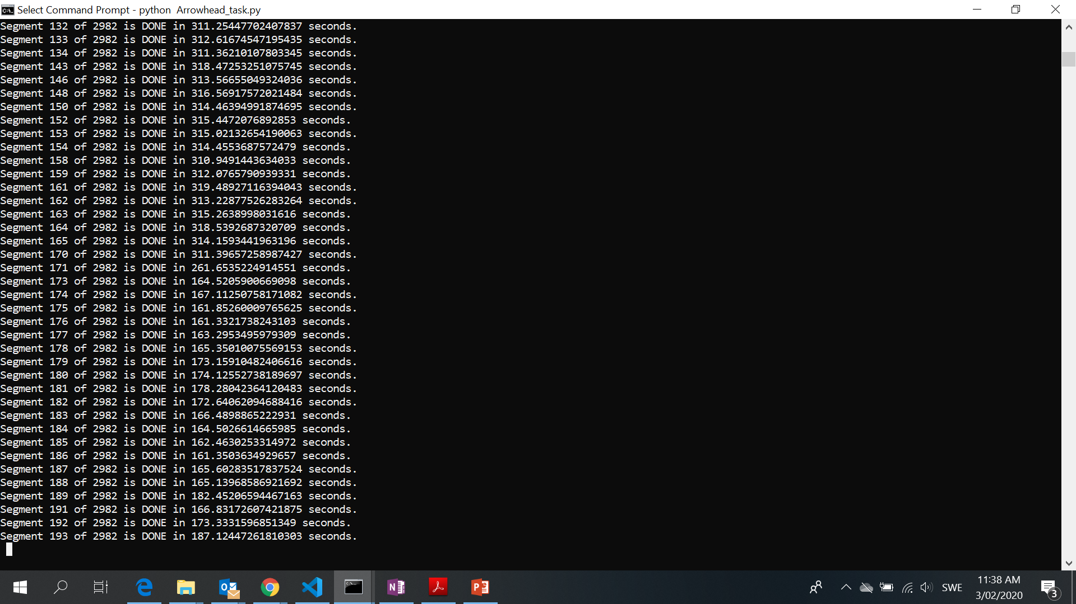

Slide 28
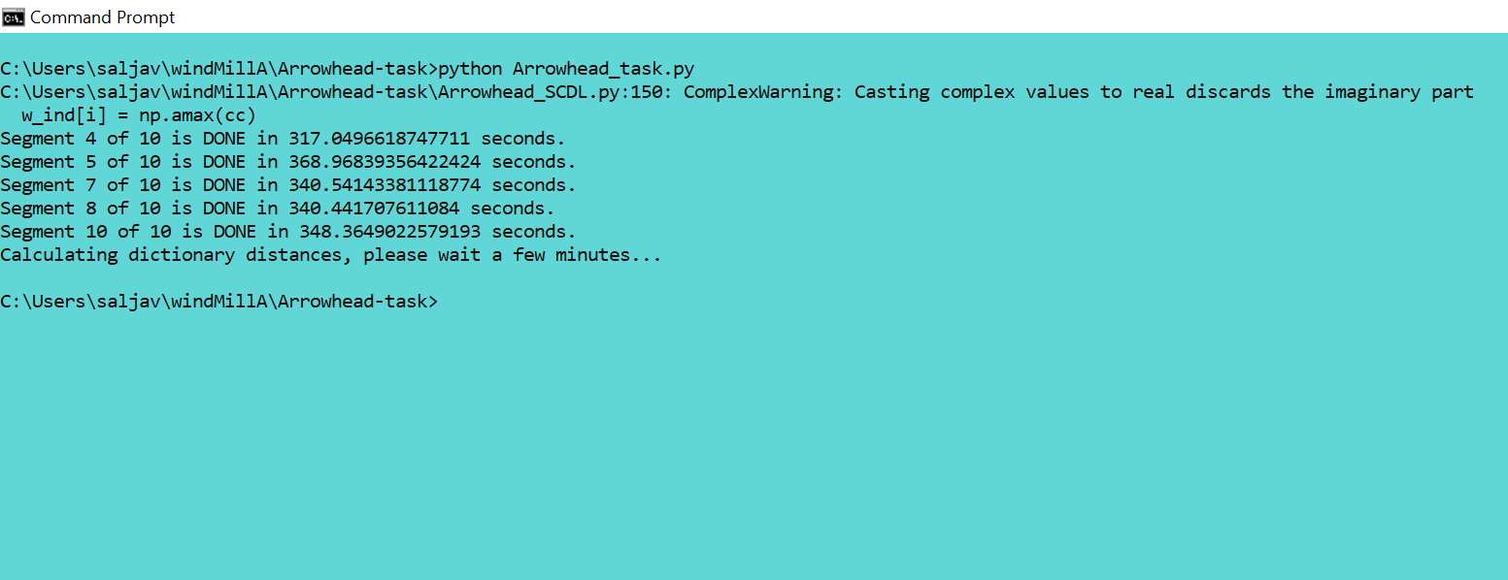
ML ANALYTICS with 10 SEGMENTS

Slide 29
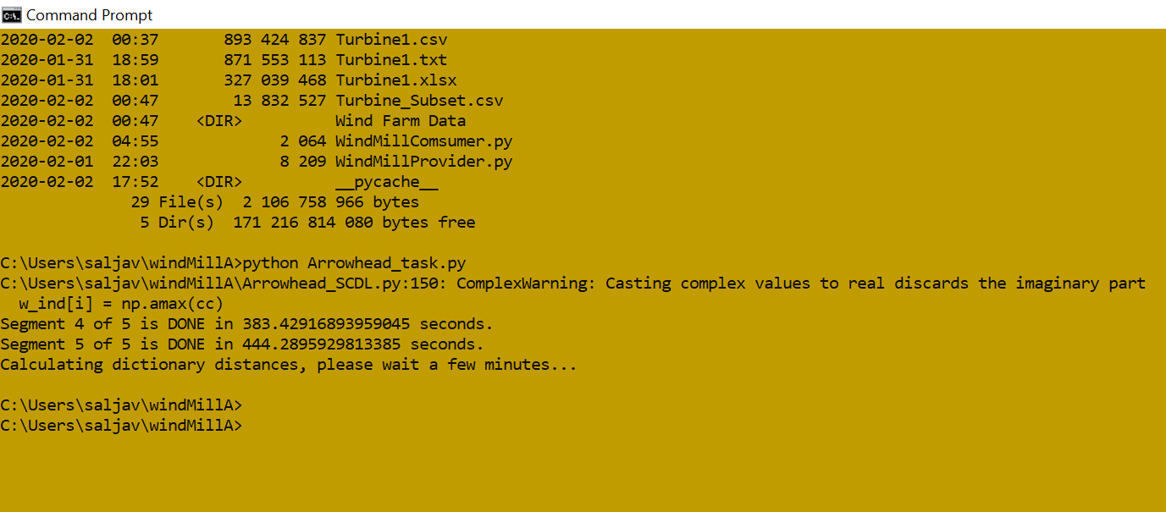
ML ANALYTICS with 10 SEGMENTS

Slide 30
Outcomes Learned
Arrowhead
– Not so Scary
Re-designing the problem
– Logic Design
Analytics Require More Attention
Yes Arrowhead Supports heavy ML Computations
A Secure Central ML DB should be created

Slide 31
Special Thanks To: Aparajita Abdullah Thank You All!

